Slide 1
Automation Tool introduction
The tool is an offline tool created for Z01. It is built based on the wgc tool of U01 and is used for bench tests, loop tests offline for the SW, HWTE, and EE, FA teams.
You must install wgc in advance
I’m still in early development phase so there is some small potential that tool may need to be updated. But I will do our best to avoid this.
GTK-RD-HWTE-SW

Slide 2
How to use this tool
GTK-RD-HWTE-SW

Slide 3
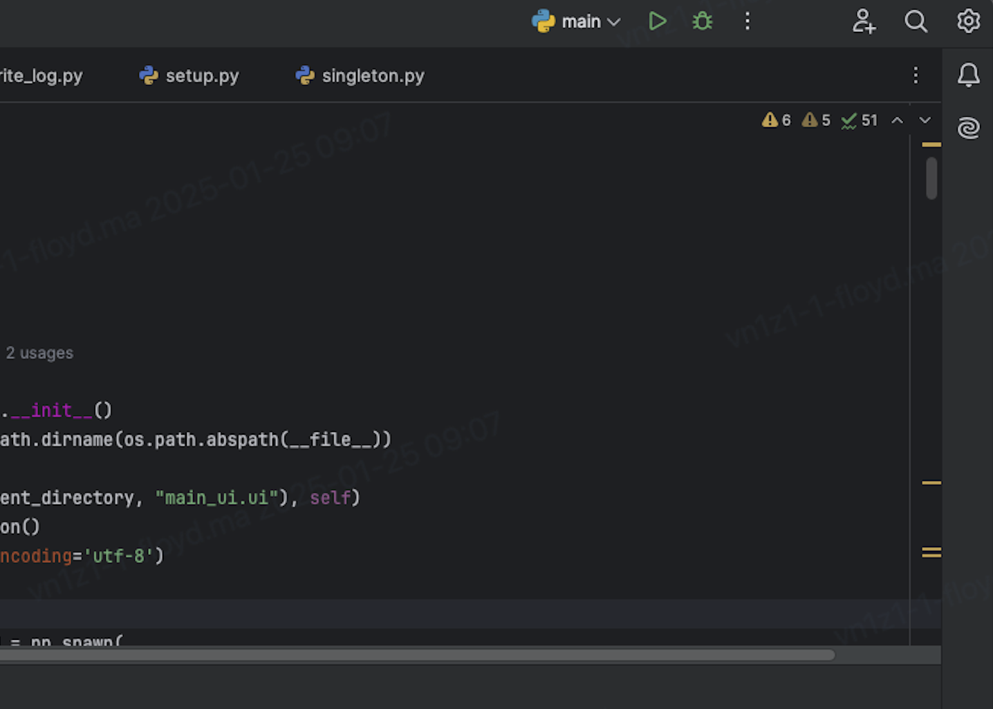
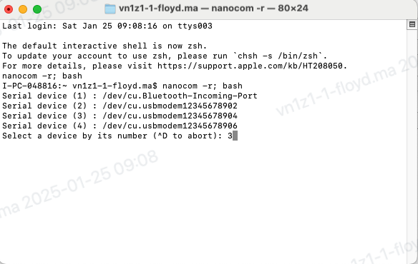
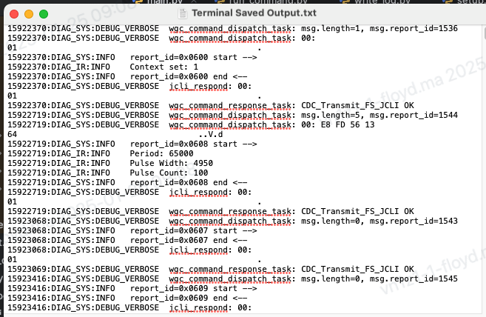
Run Tool
1. Click Run icon to run tool or open terminal then input command:
Python3 /path/main.py.
2. One terminal will be opened automatically then chose xxx04 port to record serial log
3. The serial log will be showed as below
1
2
3
GTK-RD-HWTE-SW

Slide 4
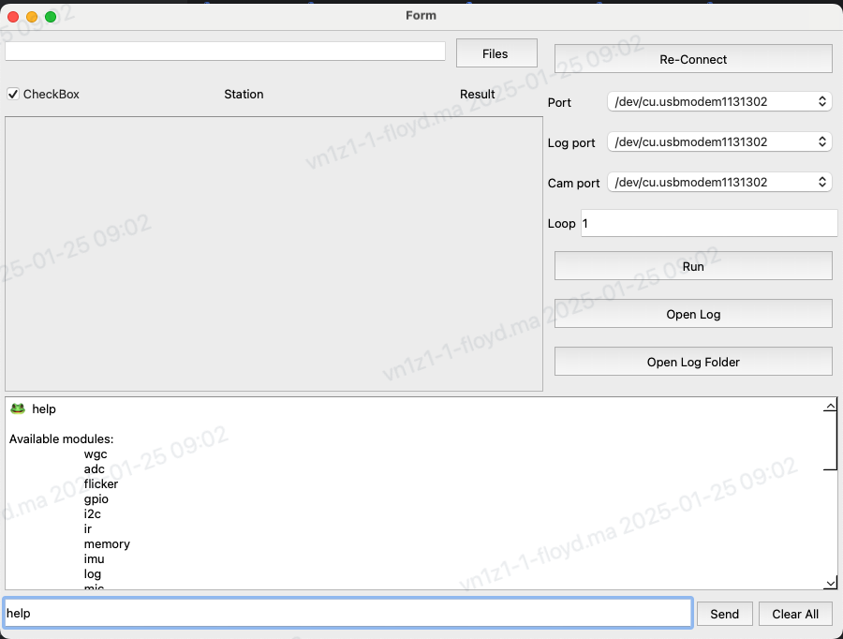
Send the single command manually
2
Input the single command, then press Enter or click the Send button to send the command.
The tool will show the result
1
GTK-RD-HWTE-SW

Slide 5
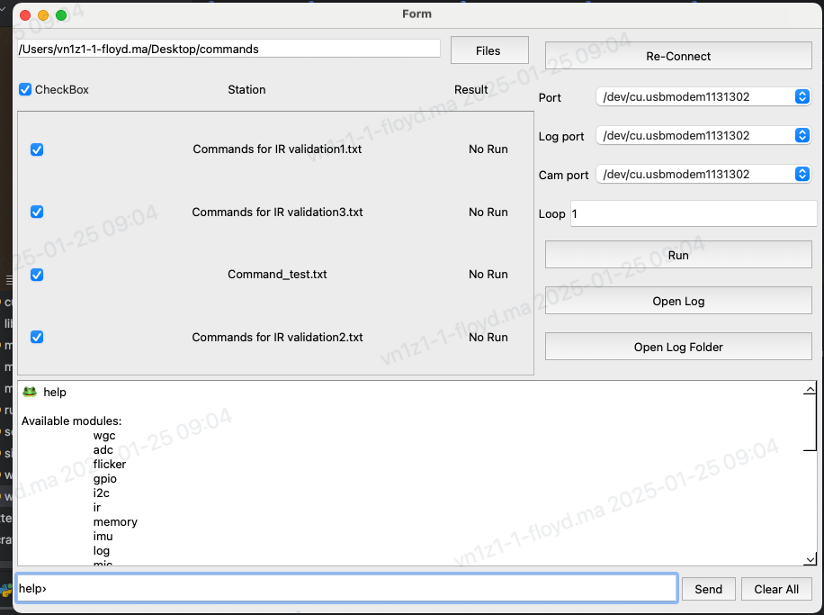
Load command list to perform loop test
1
3
Click on Files to load command list (text format)
Click the CheckBox to select all or deselect all
Click Re-Connect if DUT disconnected
Select port that you want
Select the number of loop tests you want
Click Run to start testing
4
2
5
6
GTK-RD-HWTE-SW

Slide 6
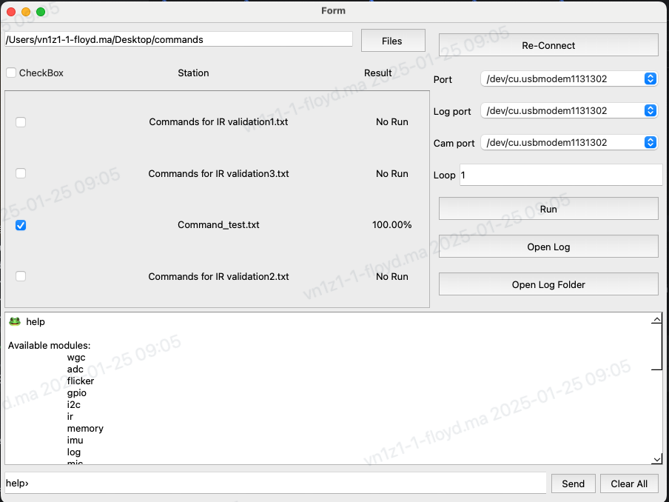
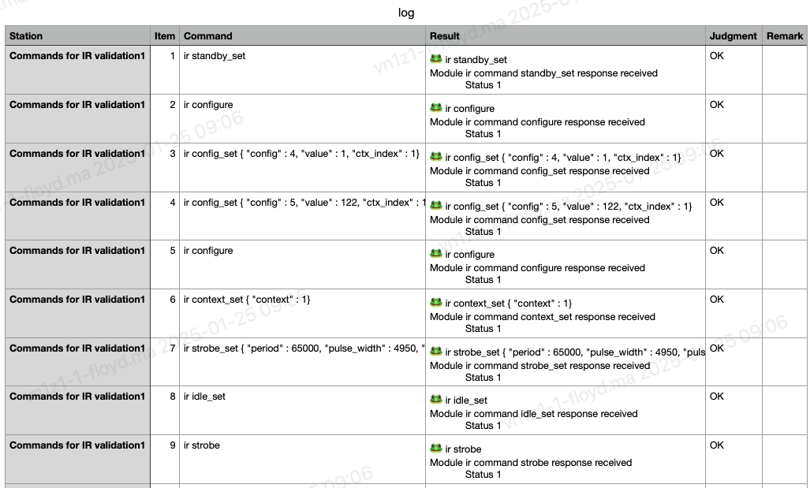
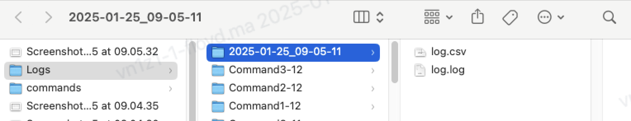
Running process and log
A result of 100% means that the item test is completed
Click Open Log to see csv log result
1
2
3
3. Click Open Log Folder to see all log
GTK-RD-HWTE-SW

